Slide 1
Session 10 – Forensics
MIS 6311-501 Cyber Security Fundamentals
Chris Davis

Slide 2
Housekeeping
Any Questions? Please do not hesitate to email. Or text.
Class Website: https://elearning.utdallas.edu
Dropbox: https://goo.gl/9AFyoE
UTD Email: cmd140430@utdallas.edu
Gmail: davischr2@gmail.com
Google Voice: 214-771-8122 (Text & Emergencies)
LinkedIn: www.LinkedIn.com/in/ChristopherDavis
Blog: www.cloudauditcontrols.com
Class: Monday 7:00pm-9:45pm JSOM 12.210

Slide 3
Academic Calendar & Sessions

Slide 4
Comparison of Our Class to CISSP Domains
Shon Harris Book – Chapters
Current CISSP Domains
2
Information Security Governance and Risk Management
8
Business Continuity and Disaster Recovery Planning
Security and Risk Management
9
Legal, Regulations, Investigations and Compliance
7
Cryptography
Security Engineering
4
Security Architecture and Design
Security Assessment and Testing
5
Physical (Environmental) Security
Asset Security
6
Telecommunications and Network Security
Communications and Network Security
3
Access Control
Identity and Access Management
11
Operations Security
Security Operations
10
Software Development Security
Software Development Security

Slide 5
Tales from the Crypt.
Practical Applications & Lessons Learned.

Slide 6
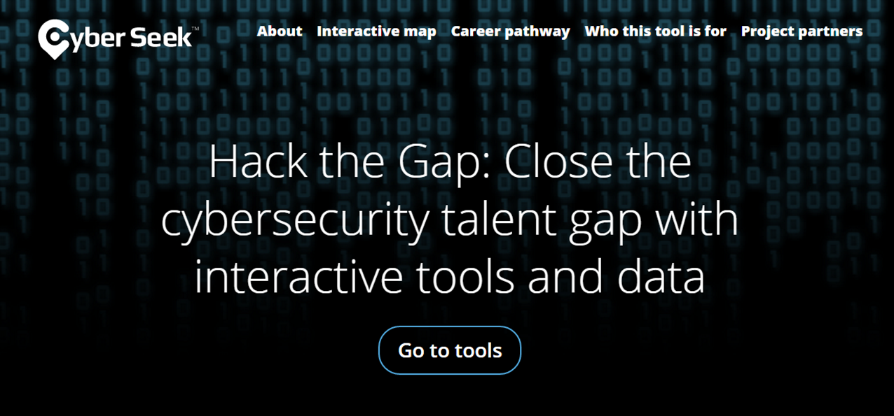
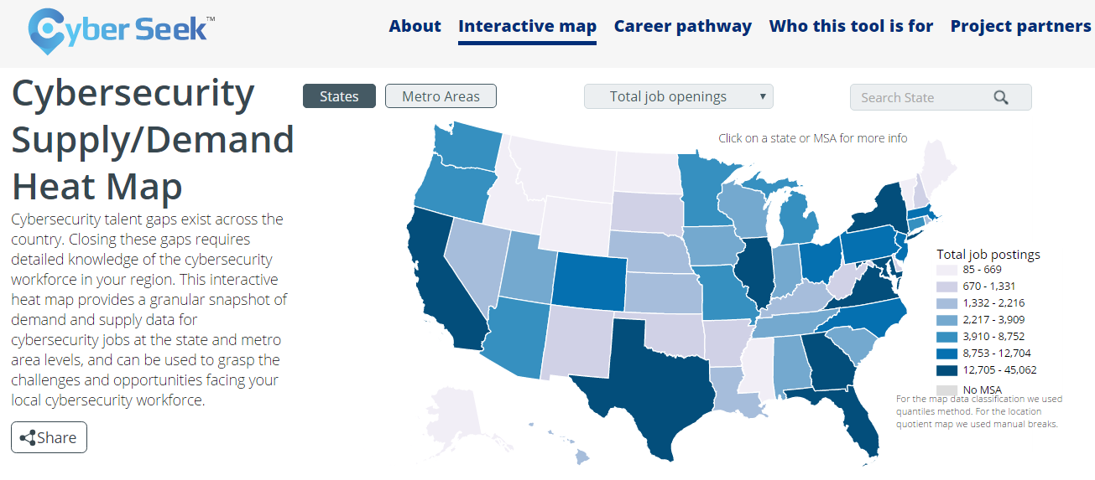
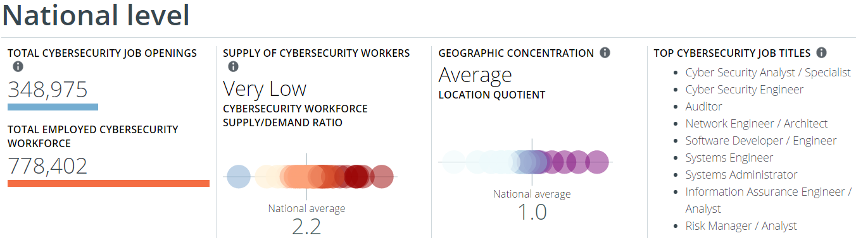
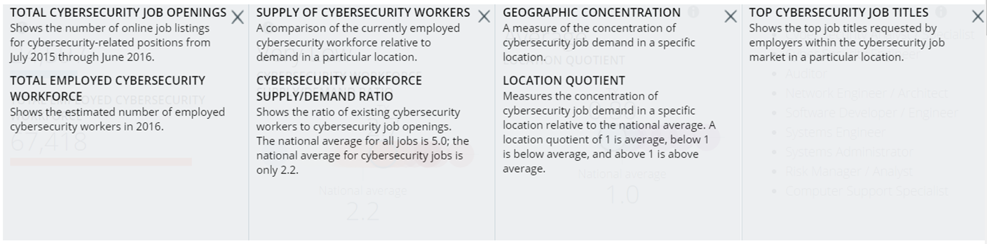
http://cyberseek.org/

Slide 7
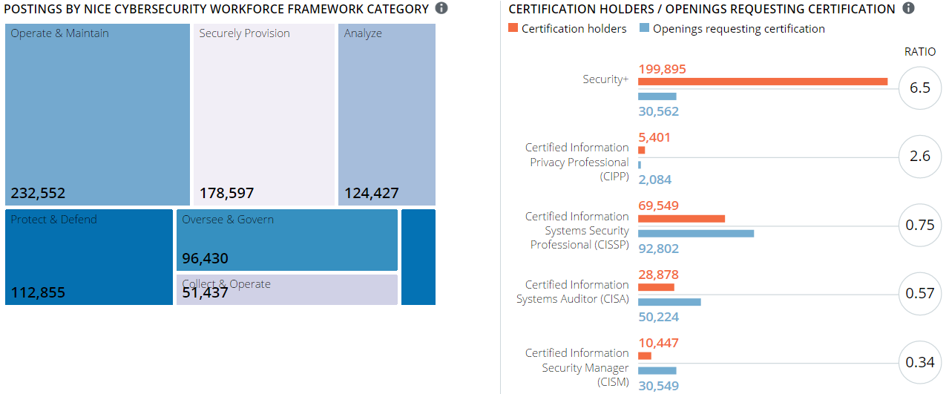
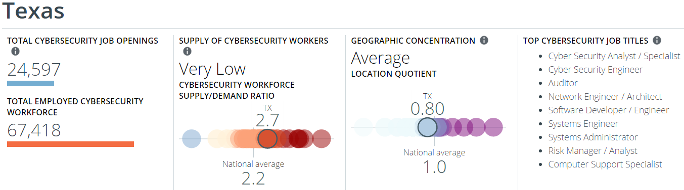

Slide 8
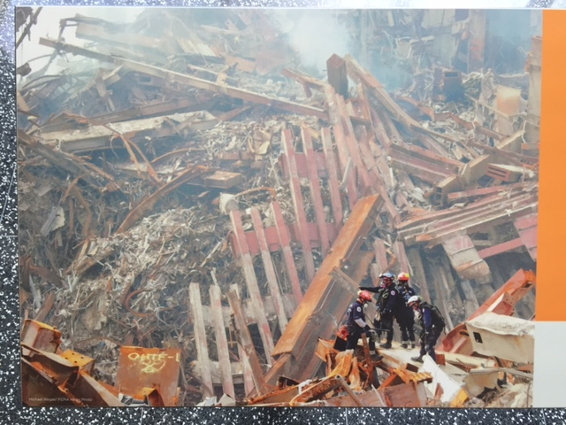
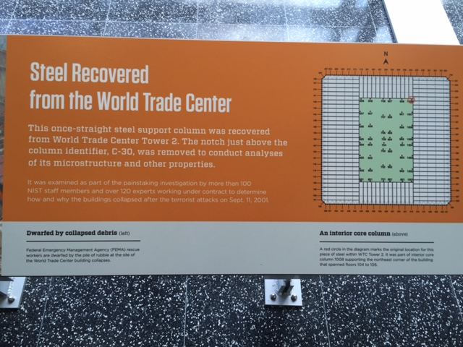
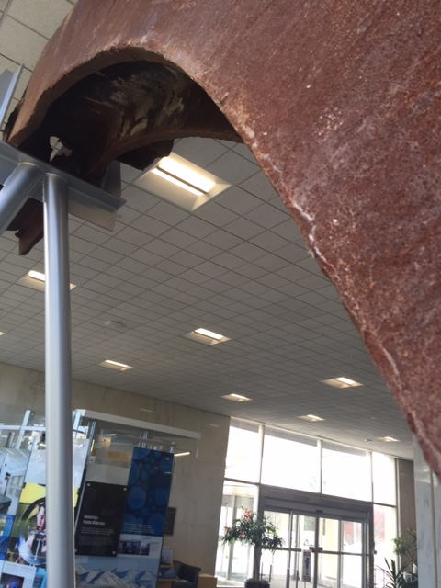
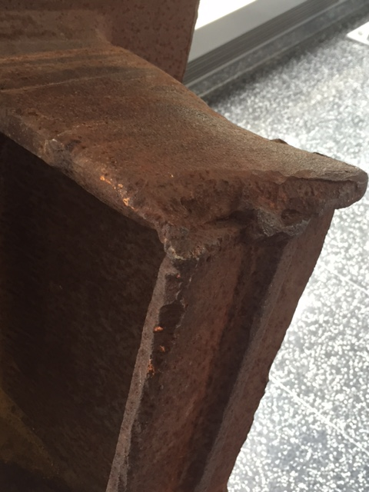
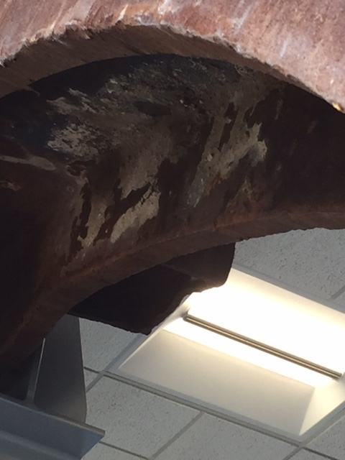
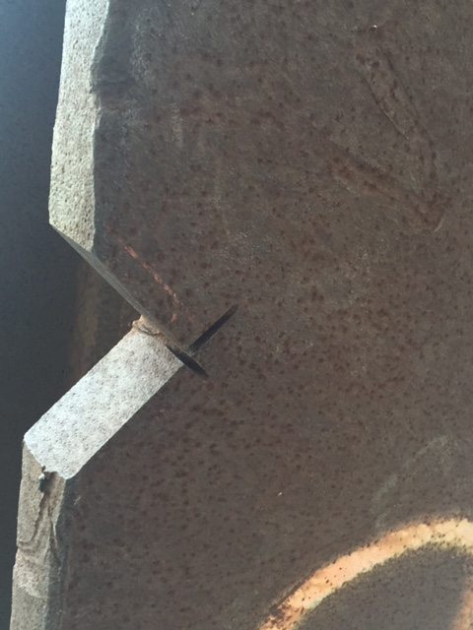
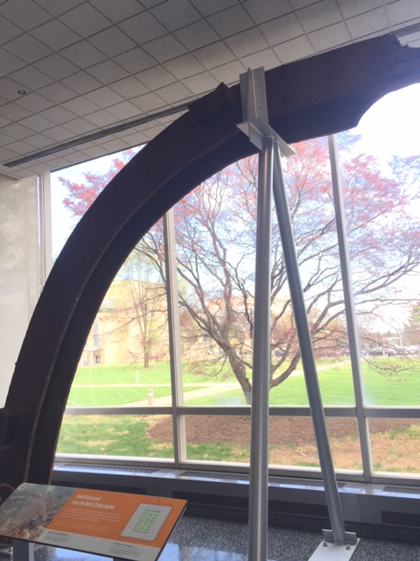
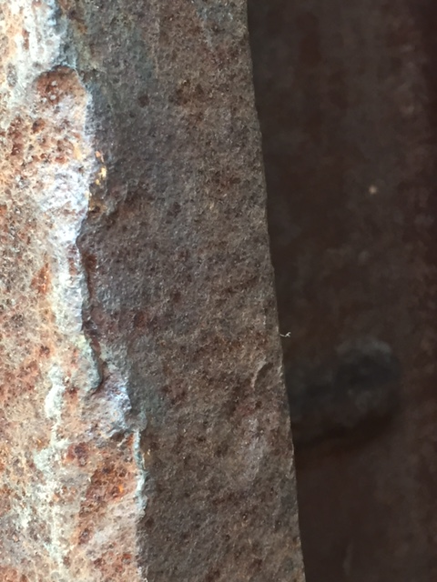

Slide 9
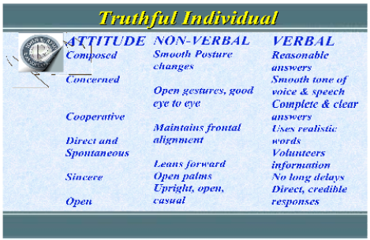

Slide 10
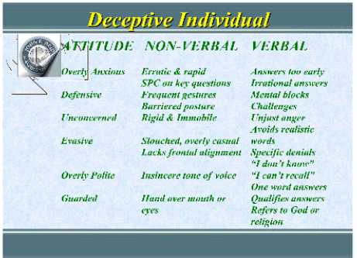

Slide 11
Interview Steps
Step | Question to Ask
 | Why are you here? Why are we asking these questions?
 | Did you do this?
 | Who do you suspect did this?
 | Is there anyone you would vouch for that would not have done this?
 | How do you feel about being interviewed about this matter?
 | Do you think it really happened?
 | Who would have the opportunity to do this?
 | Why would someone do this?
 | Has the thought ever crossed your mind to do this?
 | Why would you not carry out that thought?
 | What should happen to the individual who did this?
 | Should this person be given a second chance?
 | When this is over, how do you expect it to turn out?
 | What did you do first thing in the morning?
 | Is there any reason we would suspect you did this when we review the evidence?
Reason
You
Suspicion
Vouch
Attitude
Credibility
Opportunity
Motive
Think
Objection
Punishment
2nd Chance
Results
Alibi Account
Bait

Slide 12
Timeout for the ANONYMOUS Course Evaluation
Please get out your device and connect to the internet.
Go to the evaluation website: http://eval.utdallas.edu
Login
Fill out the course evaluation for this class.
− Or −
Look at your UTD email and there should be a message with one-click access for the evaluation for each of your courses.
You have 15 minutes to complete the evaluation for this course, and then we will resume class.
If you do not have a device you can go online and fill out the evaluation at a later time.
Note: Students who have completed ALL of their course evaluations will be given priority access to grades via CourseBook BEFORE they are available on Galaxy.

Slide 13
Job Opportunities
Please feel free to share my contact details and our company's Careers Page link (below) with the entire class and with your peers as well. All my best! Ronald “Ron” Redden Citibank - HR - North America Sr. IT Recruiter/ Professional Sourcer 6400 Las Colinas Blvd Irving, TX 75039 1.877.278.8937 fax 1.972.655.1737 direct ronald.redden@citi.com To apply for any of our open positions, please go to: https//careers.citigroup.com

Slide 14
Job Opportunities
That would be great! I might have an associate level position. > -------------------- > Hi Chris, > > Interested in hearing about new opportunities? Due to growth, our client is looking to fill a Security Implementation Consultant position (remote). Compensation includes equity. I would love to at least network. Let me know. > > Thanks! > > Missy Peterson, Recruiter > missy-peterson@austin.rr.com

Slide 15
Let’s Get Started.

Slide 16
Session Contents
This chapter presents the following:
Computer crime types • Motives and profiles of attackers • Various types of evidence • Laws and acts put into effect to fight computer crime • Computer crime investigation process and evidence collection • Incident-handling procedures • Ethics pertaining to information security and best practices
Notes:
The architecture of a computer system is very important and comprises many topics. The system has to ensure that memory is properly segregated and protected , ensure that only authorized subjects access objects, ensure that untrusted processes cannot perform activities that would put other processes at risk, control the flow of information, and define a domain of resources for each subject. It also must ensure that if the computer experiences any type of disruption, it will not result in an insecure state. Many of these issues are dealt with in the system’s security policy , and the security model is built to support the requirements of this policy. Once the security policy, model, and architecture have been developed, the computer operating system, or product, must be built, tested, evaluated, and rated. An evaluation is done by comparing the system to predefined criteria. The rating assigned to the system depends upon how it fulfills the requirements of the criteria. Customers use this rating to understand what they are really buying and how much they can trust this new product. Once the customer buys the product, it must be tested within their own environment to make sure it meets their company’s needs, which takes place through certification and accreditation processes.
Harris, Shon (2012-11-08). CISSP All-in-One Exam Guide, 6th Edition (Kindle Locations 8633-8641). McGraw-Hill Education. Kindle Edition.
Security terminology and principles • Protection control types • Security frameworks, models, standards, and best practices • Security enterprise architecture • Risk management • Security documentation • Information classification and protection • Security awareness training • Security governance
Harris, Shon (2012-11-08). CISSP All-in-One Exam Guide, 6th Edition (Kindle Locations 1007-1011). McGraw-Hill Education. Kindle Edition.

Slide 17
Chris's View

Slide 18
Importance of this Domain
This domain has special significance in real life because security practitioners needs to understand to what extent they are under legal obligation to protect data
You obligation to report or investigate computer crime is affected by:
Generally accepted morality – Ethics
Legislation governing your systems and situation
Corporate obligations such as contracts binding the individual or corporation to special terms

Slide 19

Today's Materials

Slide 20
Types of Computer Crime

Slide 21
Types of Computer Crime
Denial of Service and Distributed Denial of Service
Stealing Passwords
Network Intrusions
Emanation eavesdropping
Social engineering
Inappropriate materials
Fraud
SW piracy
Dumpster diving
Malicious code
Spoofing information
Information warfare
Espionage
Destroying or changing information
Kiddie scripts
Masquerading
Embezzlement
Data diddling
Terrorism

Slide 22
Recall: Types of Information Threats
Many of these are methods that enable a criminal act
Buffer overflows
Covert channels
Data remanence
Dumpster diving
Eavesdropping
Emanations
Impersonation
Malicious code
Trapdoor
Tunneling
MITM (Man-in-the-Middle)
Mobile (or packaged) code
Password crackers
Replay attacks
Shoulder surfing
Sniffers
Social Engineering
Spoofing IP, etc
Spying (cameras, mics)
Targeted data mining

Slide 23
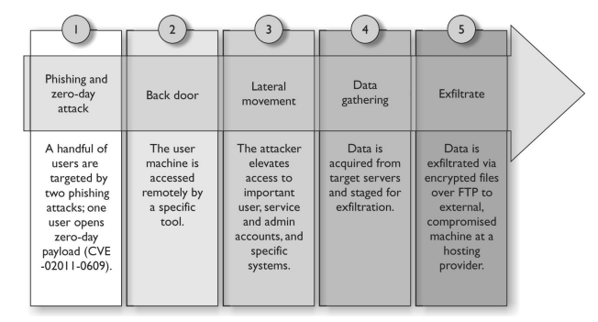
Gaining Access – Extracting Data

Slide 24
Internet Crime Schemes
http://www.ic3.gov/crimeschemes.aspx
Auction Fraud • Auction Fraud — Romania • Counterfeit Cashier's Check • Credit Card Fraud • Debt Elimination • Parcel Courier Email Scheme • Employment/Business Opportunities • Escrow Services Fraud • Identity Theft • Internet Extortion • Investment Fraud • Lotteries • Nigerian Letter or "419" • Phishing/Spoofing • Ponzi/Pyramid • Reshipping • Spam • Third Party Receiver of Funds

Slide 25
The Legal System

Slide 26
Different Legal Systems
“Common Law” Legal System
Also called case law. Law established by subject matter heard in earlier cases
Practiced by many generally English-speaking or influenced countries or Commonwealth countries
Used in Continental Europe, and most of the rest of the world
These include England and Wales, the Republic of Ireland, the United States (except Louisiana), Canada (except Quebec civil law), Australia, New Zealand, South Africa, India
Law based on a series of written codes or laws
Islamic and other religious law

Slide 27
World Legal Systems
Civil law system
Uses prewritten rules and is not based on precedence.
Is different from civil (tort) laws, which work under a common law system.
Common law system
Made up of criminal, civil, and administrative laws.
Customary law system
Addresses mainly personal conduct , and uses regional traditions and customs as the foundations of the laws.
Is usually mixed with another type of listed legal system rather than being the sole legal system used in a region.
Religious law system
Laws are derived from religious beliefs and address an individual’s religious responsibilities; commonly used in Muslim countries or regions.
Mixed law system
Uses two or more legal systems.

Slide 28
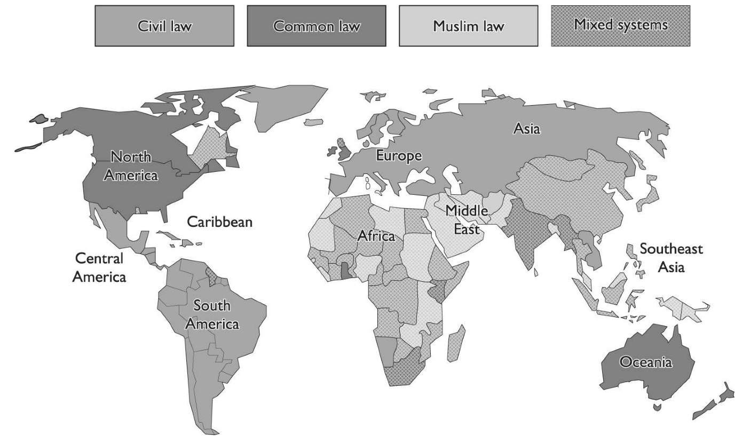
World Legal Systems

Slide 29
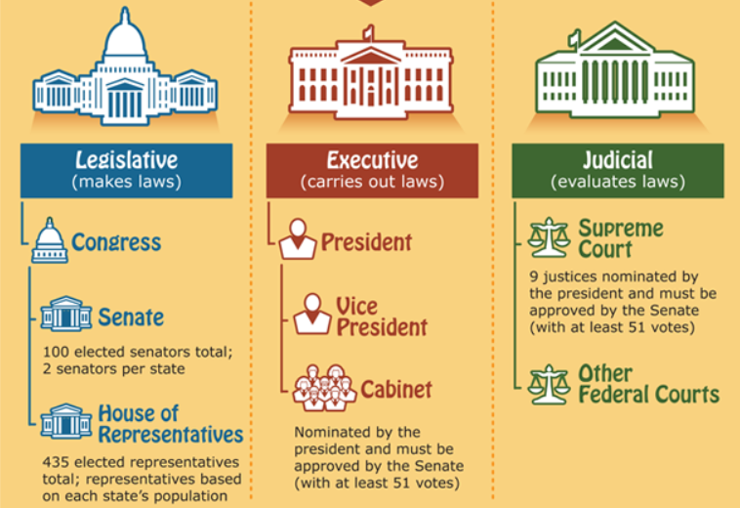
United States—Common Law System
U.S. Constitution:
Supreme law of the land.
No other laws may conflict.
Three government branches.
Each branch “creates” laws.
Executive
Legislative
Judicial
Created laws are binding on the court:
Executive Branch: Regulations promulgated by the executive branch create “administrative law.”
Legislative Branch: Statutes enacted by the legislative branch create “statutory law.”
Judicial Branch: Court decisions made by the judicial branch create “case or common law.”

Slide 30
United States—Common Law System
Administrative—Administrative Law
Laws pertaining to specific areas such as taxes, transportation, and labor in the form of proclamations, executive orders, and regulations
Legislative—Statutory Law
Relating to a written law from the perceived need to clarify the functioning of government, improve civil order, answer a public need, to codify existing law, or for an individual or company to obtain special treatment
Judicial—Common Law
Also case law. Law established by subject matter heard in earlier cases, which is precedent, and then also tradition and custom

Slide 31
Common Law Breakdown
Criminal, Civil, Administrative
Criminal
Affects public interests
Punishment can include money and prison
Burden of proof
E.g. Physical assault
Civil
Affects individual or organizational interests
Punishment can include money – NO Prison
No burden of proof
E.g. Cisco suing over IP theft
Administrative/regulatory
Industries, organizations, officials, officers violate standards expected by government agencies
Punishment can include money and prison
E.g. Martha Stewart – SEC reporting

Slide 32
Intellectual Property

Slide 33
IP: Intellectual Property Concerns
Patents
Exclude others from practicing the invention
E.g. Microprocessor
Copyrights
Protects original works of authorship
E.g. Books and software
Trade Secrets
Secrets that provides business advantage
Typically [1] company developed, [2] valuable to company, [3] valuable to competitor, and [4] not intuitive or obvious to develop or create
E.g. Baking company’s special cookie recipe
Trademarks
Word, name, symbol, color, sound, product shape, device, or combination of these used to identify goods or services
E.g. Nike swoosh

Slide 34
Monitoring

Slide 35
Electronic Monitoring
People: Formally inform people that work for the company that the company reserves the right to electronically monitor employees to protect company interests
Process: Ensure you have the following:
Policies!!!
Policies make it easier to enforce behavior
Provides legal support for court cases
Provides layer of abstraction for personal interactions

Slide 36
Electronic Monitoring
Tools:
Banner, banner, banner – have a banner!
Consider cost vs. reward of monitoring systems
Some tools are more effective than others and other tools may not justify the additional project and operational costs
Measures: Ensure you have the following:
Banner, banner, banner – have a banner!
Policies!!!
Policies make it easier to enforce behavior
Provides legal support for court cases
Provides layer of abstraction for personal interactions

Slide 37
Enticement vs. Entrapment
Enticement:
“Now that you’re here, let’s stay a while!”
lure: qualities that attract by seeming to promise some kind of reward
E.g. Honeypots
Entrapment:
“I’m going to trap you and make you commit a crime!”
A defense to criminal charges alleging that agents of the government induced a person to commit a crime he or she otherwise would not have committed

Slide 38
Investigations

Slide 39
Important Laws
Laws form important basis for what and how an Incident Response or Forensics team responds
Statutory Law
Administrative Law
Common Law
Criminal: Physical assault
Civil: Cisco suing over IP theft
Administrative/regulatory: Martha Stewart – SEC reporting
A person must be tried by a representative of the people for criminal acts
First party knowledge is a must
Rules are closer to black and white
If you have a criminal case:
STOP WHAT YOU ARE DOING AND CONSULT THE POLICE, SECRET SERVICE, OR FBI

Slide 40
Determine if Event is Criminal or Civil
Criminal
Monetary damages on the order of tens of thousands
Digital evidence depicting, promoting or sanctioning physical harm or violation of another human being
E.g. … Many
Successful prosecution results in prison and monetary damages
Civil
Monetary damage doesn’t exist or is very small
Violation of corporate policy
Successful prosecution results in monetary damages
E.g. One company suing another company
Does not require police involvement

Slide 41
Common Investigation Issues
Investigations also called Forensics
Forensics is not always perfect
Challenges include:
Compressed timeframe
Intangible information
Investigation might affect business productivity
Co-mingling of data
Need expert or specialist
Geographic separation
Alerted suspect
Staff not trained in investigation techniques
Data overload (triage concept)

Slide 42
Chain of Custody
Chain of Evidence
Make sure to formally record information about your evidence as you go:
Where found
Time found
Name of who found it
Name of who took it
Name of who keeps it
Keep in safe, secure location
Only allow trained investigators to work on the evidence
Do not curiously “examine” evidence
Document every time you move it

Slide 43
Evidence Admissibility
Must be:
Relevant
Relevant to crime
Legally Permissible
Obtained lawfully
Reliable
Integrity is sound; chain of custody is sound
Identified
Properly marked
Preserved
Protected from damage or destruction

Slide 44
Types of Evidence
There are many types of evidence. We just need to recognize and understand the most important ones that will directly influence the role of a computer forensic investigator
Best Evidence
E.g. Original written letter
However, the Best Evidence RULE states original artifact must be produced unless the party can account satisfactorily for its absence
Secondary Evidence
Copy of the original
Could be oral description in place of the real thing
Direct Evidence
Directly witnessed
Eye-witness; five senses

Slide 45
Types of Evidence
Conclusive Evidence
Indisputable
Opinions
Non-expert: Testify facts only
Expert: Testify opinion based on facts and expertise in the subject matter
Court definition of an expert: One who knows more than the general public in a particular area
Opinions delivered to the court through depositions (mostly) and court appearances (sometimes)
Circumstantial
tends to prove a factual matter by proving other events or circumstances, inferring the occurrence of the matter at issue
Hearsay
Third party; not usually admissible; see exceptions

Slide 46
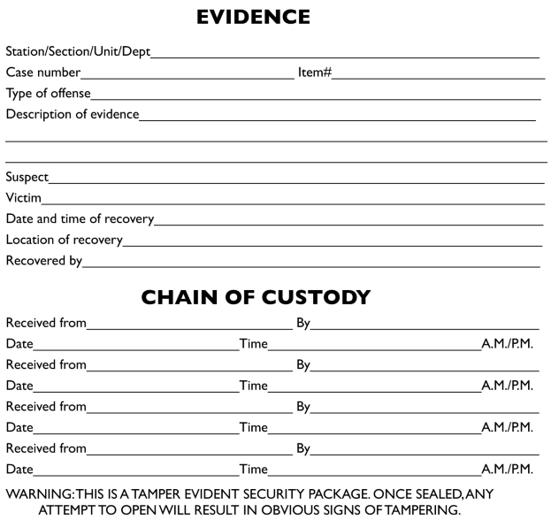
Evidence Chain of Custody Form

Slide 47
The Investigation: Before
Note on Policies and Procedures
Policies establish rules to follow
Strategic in nature
Procedures establish details on following the rules
Tactical in nature
Should have both governing use of [1] IT assets and [2] forensics team (detailing their processes)
Liaisons
Internal: HR; Legal; Corporate (physical) Security; Management
External: Local Police; FBI; USSS

Slide 48
The Investigation: During
Decision Points
Bringing in the Law
Trained… but…
Loose control of investigation
Requires warrants (protects rights)
If Civil case, may prefer not bringing in the law
Exigent Circumstances Doctrine: Present cause & evidence destruction imminent; no warrant required
Evidence
Web traffic; email; backups; witnesses; surveillance video; logs; audit trails; telephones records; mainframe records
Interview
Leave it to professionals
They use professional training and tools
MOM
Motive; Opportunity; Means

Slide 49
Corporate Liability

Slide 50
1997 Federal Sentencing Guidelines
The Federal Sentencing Guidelines were extended in 1997 to encompass computer crime
The guidelines treat the possession of illegally acquired material – even without the intention to make money from it or resell it – as a crime
Corporate Officers were made personally liable up to $290MM to protect organization from losses due to:
Natural disasters; Malicious code; Compromise of sensitive IP; Damaged reputation; Violating the law; Employee privacy suits; Stockholder suits
Prudent Man Rule: Do as prudent man would do
“requires officers to perform duties with diligence and care that ordinary, prudent people would exercise under similar circumstances”
Protections MUST have – see list next slide
C < L ➔ legally liable
Protection Cost < Estimated Loss

Slide 51
Corporate Must Haves
Exercising “Due Care” or “Reasonable Care” includes:
Institute measures to prevent own systems from being used to attack other entities
Implement backups
Scan for malicious code
Business continuity / Disaster recovery plans
Local and remote access controls
Eliminate unauthorized and open modems
Have security policies, procedures and guidelines
Use personnel screening procedures
Establish an incident handling capability
Legal liability exists if the cost to implement solution is less than the cost of a successful attack on the data
Cost < Loss = Legal Liability

Slide 52
Note on Export Controls
If you deal with this frequently then consult this link for the latest information:
Export controls: http://www.bxa.doc.gov/Encryption/Default.htm
Restriction to Country Group E:1
Cuba, Iran, Libya, Syria, and Sudan
Prevents exports and re-exports of encryption source code and technology to
[1] these countries and
[2] nationals of these countries
EU "license-free zone“
Just about everyone in Europe (should know this)
Just for fun… (don’t need this level of detail)
Austria, Australia, Belgium, Cyprus, Czech Republic, Denmark, Estonia, Finland, France, Germany, Greece, Hungary, Ireland, Italy, Japan, Latvia, Lithuania, Luxembourg, Malta, Netherlands, New Zealand, Norway, Poland, Portugal, Slovakia, Slovenia, Spain, Sweden, Switzerland, and United Kingdom

Slide 53
Ethics

Slide 54
Note on Ethics
Integrity
Doing what’s right despite anyone else watching or not watching, caring or not caring.
ISC2 Code of Ethics
Ten Commandments of Computer Ethics
RFC 1087: Internet Activities Board (IAB) Ethics and the Internet
US Department of Health, Education, and Welfare Code of Fair Information Practices
Organization for Economic Cooperation and Development (OECD)

Slide 55
Sources
The CISSP Prep Guide Gold Edition
Official ISC2 Guide to the CISSP Exam
Legal Dictionary: http://dictionary.lp.findlaw.com/
Short Legal Terms: http://brandonlclark.com/glossary.html
Statutory Law: http://en.wikipedia.org/wiki/Statutory_law
Texas Legal: http://www.sll.state.tx.us/index.asp
Export controls: http://www.bxa.doc.gov/Encryption/Default.htm
Reid Behavioral Investigations: http://www.reid.com/
CERT: http://www.cert.org/

Slide 56
WARNING!!! (SOME) DUPLICATE MATERIALS AHEAD…
This is good.

Slide 57
Chapter 10: Laws and Regulations – the Long(er) Version

Slide 58
Background
As technology increases and becomes more and more complex and people integrate it more and more, computer crime becomes a new avenue for criminals.
Identity theft
Trade secrets (corporate espionage)
Fraud
Computer crime is the fastest growing white collar crime.

Slide 59
Background
Computer crime laws (cyber law) when they exist deal with some of the core issues.
Un authorized modification
Destruction
Disclosure of secret information
Un authorized access

Slide 60
Background
There are 3 categories of computer crime
Computer assisted crime – computer as a tool
Computer targeted crime – computer is the victim
Computer incidental – not attacker or victim, just happened to be involved but involvement is insignificant

Slide 61
Background
The reason these 3 categories are created is to try to help computer law into current laws (example so trespassing laws can apply to computer access, rather than creating new computer specific laws)

Slide 62
Complexities in Cybercrime
It is very difficult to prosecute cybercrime
Laws are fairly new if they exist at all, they are also not often complete
Hackers can commit crimes without any physical evidence
Hackers can spoof addresses, or attack from other machines than they simple clean or destroy
Attackers can setup zombie/botnet armies

Slide 63
Complexities in Cybercrime
Not everyone reports breaches (
in fact many companies do not due to public relations concerns
Companies often don’t understand security and it’s implications, or they don’t want to deal with it because they see it as only a cost. They don’t understand how much it can cost NOT to provide proper security.

Slide 64
Evolutions of Attacks
Years ago attackers where mainly made up of technical people who were interested in how things worked. Some of this was just for curiosity some was for bragging rights.
Then script kiddies* came on board, again mostly to be “cool”
However as there is more assets in computing, organized crime is now involved.

Slide 65
Problems of Different Countries
It’s hard enough to prosecute crime in one country, however what about hacking between countries? What laws apply, What country should prosecute, How/will they share information. Will they even co-operate?
Example:
If someone in North Korea attacked the US, do you think NK would assist?

Slide 66
Types of Law
There are different kinds of legal systems. You need to understand these systems for the exam.
Civil (Code) Law
Common Law
Customary Law
Religious Law
Mixed law

Slide 67
Civil Law
System of Law used in France and Spain
Different than Common law used in the UK and US
Rule based NOT precedence based
Focused on written/codified laws
Not the same as civil (or tort) laws in the US

Slide 68
Common Law
Developed in England
Based on previous interpretation of law (precedence)
Today it uses Judges and juries of peers
Broken down into (more later)
Criminal
Civil
Regulatory
Innocent until proven guilty
US, Canada, UK, Australia, New Zealand

Slide 69
Criminal Law (common law subtype)
Defined as individual conduct violating government laws enacted for the protection of the people.
Conviction usually results in jail time
Could end in financial restitution
Main purpose is punishment for the offender
Jury must find beyond a reasonable doubt

Slide 70
Civil law (common law subtype)
Called “tort law”, it is defined as a wrong against an individual or business, typically resulting in damage or loss to an entity.
Major difference between criminal and civil is the level of proof needed (less in civil) and there is no jail sentence in civil. Either financial or injunctive relief.
(more)

Slide 71
Civil Law (common law subtype)
With Financial restitution damages can be
Compensatory damages – repay damage
Punitive damages – punish
Statutory damages – determined by law, violation of the law entitles the victim to a statutory award.

Slide 72
Customary Law
Deals with personal conduct and behavior
Based on traditions
Used in regions where there are mixed legal systems (China, India)
Emerged when co-operation of individuals became necessary
No purely customary law practiced, mixed with other forms

Slide 73
Religious Law
Based on religious beliefs
Commonly divided into
Responsibilities to others
Religious duties
Rules are defined by their deities'
Also involve morality.

Slide 74
Mixed Law
Two or more legal systems
For example may use civil law in regards to certain crimes and religious law in regards to other crimes.

Slide 75
Intellectual Property Law
Not necessarily concerned with right or wrong, but how a company can protect what it owns.
A major issue involved with IPL is what a company did to protect it’s resources.
Generally a company must show that data is specifically important, and that it took appropriate steps to protect it.

Slide 76
IPL
Type of IPL laws
Trade Secret
Copyright
Trademark
Patent
Each is explained on the upcoming slides.

Slide 77
Trade Secret
Some information that provides the company with some type of competitive advantage.
A trade secret is important for a companies survivability and profitability.
Examples: formula used for coke.

Slide 78
Copyright
Protects the rights of an author to control the public distribution, display and adaption of his original work.
It does not protect a specific resources, but protects the expression of the idea.
Source code for software can be copyrighted.
Protects the un authorized copying and distribution of a work.

Slide 79
Trademark
Used to protect a work, name, symbol, sound, shape, color or combination of these..
A marketing concept.

Slide 80
Patent
Ownership of an idea or invention.
Idea must be
Novel - different from anything seen or known before
Useful
Not obvious
Applies for a specific period of time. Algorithms can be patented.
Other companies can license an idea in which they pay the company that holds the patent for the right to use their idea.

Slide 81
International Protection of Property
When you have a resource you want to protect you integrate the data into the companies data classification scheme. This should be directed by management and carried out by the IT staff. The resources should have the necessary level of access control, auditing, and proper storage. This is due care… If a company fails in this, it may not be protected by laws.

Slide 82
Software Piracy
Generally companies license software (right to use) legally. However piracy does occur in some companies, and piracy is rampant with individuals. Some organizations help enforce proper use of software
SPA – formed by companies
FAST – Federation Against Software Theft
BSA – Business Software Alliance

Slide 83
Software Piracy
Often to break copy protection software is “decompiled”. Decompiling can show how to exploit security holes, however it’s often done to disable copy protection mechanisms and license checks.
The DMCA (Digital Millennium Copyright Act) makes it illegal to create products that circumvent copyright protection.

Slide 84
Privacy
With the rise of technology and all kinds of information and processing happening with computers privacy is becoming threatened. Many countries are implementing laws to protect individuals data. Usually these law require something along the lines of

Slide 85
Piracy
Data may only be used for the purposes it was collected.
Data may only be held for a reasonable amount of time
If data is collected on you, you have a right to receive a report outlining the data collected
Information must be accurate, kept up to date and not disclosed to a third party without permission.
People have the right to make corrections to their information.
If data is to be transmitted to a location where the data cannot be protected then transmission is prohibited

Slide 86
Privacy
Consideration of Privacy
The following issues have increased the need for more privacy laws and regulation
Data Aggregation and retrieval technologies advancement
Loss of borders (data travelling across borders)
Convergent technologies advancement – gathering, mining and distributing information

Slide 87
Different Laws and Regulations
Some important laws and regulations we will talk about are
Sarbanes Oxley (SOX)
Health Insurance Portability and Accountability Act (HIPPA)
Gramm-Leach-Bliley Act of 1999 (GLBA)
Computer Fraud and Abuse Act
Federal Privacy Act of 1974

Slide 88
Different Laws and Regulations
Basel II
PCI DSS
Computer Security Act of 1987
Economic Espionage Act of 1996

Slide 89
SOX
Sarbanes Oxley was created in the wake of corporate scandals and fraud which costs investors billions of dollars.
Applies to any publically traded company
Governs Accounting Practices
Some parts apply directly to Information Technology
(more)

Slide 90
SOX
Provides requirements on how companies must trade manage and report on their financials.
Failure to comply can lead to stiff penalties and possible jail time for company executives. (CEO, CFO etc)

Slide 91
HIPPA
Health Insurance Portability and Accountability Act (HIPPA)
Provided to provide national standards and procedures for the storage, use and transmission of personal medical information.
HIPPA mandates penalties for non-compliance even by mistake.
$100 per incident up to $25,000.
If knowingly violated $50,000 and 1 year in prison
If on purpose $250,000 and 10 years in prison

Slide 92
Gramm-Leach-Bliley Act of 1999
Requires financial information to develop privacy notices and give their customers the option to prohibit financial institutions from sharing their information with 3rd parties.
This act dictates that the board of directors is responsible for many of the security issues in a financial institution.
Dictates that risk management and due care concepts must be practiced
Requires a written security policy

Slide 93
Computer Fraud and Abuse Act
This act was written in 1986 and amended in 1996, and is the primary “anti-hacking” statute. It prohibits 7 kinds of crime.
Knowingly accessing federal government computers in an attempt to access classified information
Intentional access of a computer to obtain information from an financial institution, federal government or any protected computer involved in interstate or foreign commerce.

Slide 94
Computer Fraud and Abuse Act
The international and un authorized access of computers of the federal government or used by the federal governments.
The knowing access of a protected computer without authorization
Knowingly causing the transmission of a program, information, code or command and as a result of such conduct intentionally causing damage without authorization to a protected computer
(more)

Slide 95
Computer Fraud and Abuse Act
The knowing trafficking of computer passwords with the intent to defraud
The transmissions of communications containing threats to cause damage to a protected computer
Note: all these requires that the computer is protected and the access unauthorized

Slide 96
Federal Privacy Act of 1974
Applies to records and documents developed and maintained by specific branches of the federal government. (not congressional, judiciary and territorial subdivisions)
The act dictates that agency cannot disclose the information without permission from the individual.*
Data can be collected, but must be relevant and necessary for it’s purpose.*

Slide 97
Basel II
A means of protecting banks from overextending themselves and becoming insolvent.
Built on 3 main components called pillars
Minimum Capital requirements
Supervision – a framework for oversight and risk analysis
Market Discipline – requires members to disclose exposure to risk and validate adequate market capital.

Slide 98
PCI DSS
Created by the Credit Card industry to stabilize customer trust, companies started with their own initiatives, but eventually came together with PCI DSS.
Applies to any entity that process, transmits, stores, and accepts credit card data.
Varying levels of compliance and penalties exist and depend on the size of the customer and the volume of transactions.
12 main requirements
Private sector initiative, NOT law.

Slide 99
Computer Security Act of 1987
Requires US federal agencies to identify computers systems that contain sensitive information.
Agencies must develop a security policy for each system and conduct training for individuals involved with these systems.

Slide 100
Economic Espionage Act of 1996
Provides the structure when dealing with corporate espionage.
This allows the FBI to investigate corporate espionage cases.

Slide 101
Employee Privacy Issues
In any work environment the company must be able to protect it’s resources. Part of this will be monitoring employees activities.. However you must be careful.
A company MUST take proper steps to ensure that the employees KNOW what type of monitoring can take place. If they don’t they can be sued for violation of privacy laws.

Slide 102
Employee Privacy Issues
Monitoring must be work related.
Monitoring must be done in a consistent way, and should happen in a broad manner. rather than just one or two people that are being monitored.
Any monitoring should be stated in the security policy,
Stated in employment agreements (which are signed by the employee)
Login BANNERS* should be when they log in, stating that they will be monitored.
(more)

Slide 103
Employee Privacy Issues
Email monitoring policy should state who can and cannot read employee messages and where they can read messages.
A company must not promise privacy and then read messages, otherwise they may be sued.
A company MUST state what types of activity are and are not allowed.

Slide 104
Company Liability issues
Due Diligence – Research into risks
Due Care – operational activities to mitigate risk
Downstream liability – if we give private information to another company (partner maybe) and they don’t protect it, properly we can be sued.
Cracker attacks – if a company does not provide the necessary level of protection and personal or financial data is stolen, they may also be held liable for being negligent in it’s protection of data.

Slide 105
Computer Forensic Investigation

Slide 106
Investigations
Computer Crimes are increasing, security professionals should understand how investigations should be carried out.
It is critical that any computer investigation be carried out in a way such that evidence is admissible in court. There are many steps that we need to carry out appropriately. Which we will talk about soon.

Slide 107
Incident Response
Terms
Event – a negative occurrence that can be observed, verified and documented.
Incident – a series of events that negatively affects the company or impacts it’s security posture.

Slide 108
Incident Response
It is very important that a response to an incident be in a controlled an methodic manner. Once detected the evidence should remain unaltered until someone familiar with the proper procedures for collecting data from a computer crime can be involved. Otherwise data can be destroyed or invalidated.
There should also be a company incident response policy that lays out procedures. It should indicate if a system should immediately be taken off line, or continue functioning (why would we do either?) and cover other concerns.

Slide 109
Incident Response
All organizations should also develop an incident response team. The team should have
Someone from senior management
A network administrator / system admin
Security officer
Public affairs personnel etc

Slide 110
Incident Response team
There should be a set of predetermined steps that are taken to ensure uniformity and that no steps are skipped. (see later)
Part of the plan should determine whether the company just “fixes” the problem or tries to prosecute.
If the team determines a response has happened senior management should be immediately notified.
HR should be notified if a suspect is an employee.
Incident response should be part of the companies Disaster Recovery Plan (why?)

Slide 111
Incident Response Procedures
We said earlier there should be a set of procedures for incident response, these can vary from company to company, here are ISC2 recommended procedures
Triage
Reaction
Follow Up
We will talk about each of these

Slide 112
IRP Step 1: Triage
Triage – determine what systems/networks etc have been compromised, determine the extent of compromise. Set priorities.

Slide 113
IRP Step 2: Reaction
Reaction contains 3 steps
Containment – what is this? What are the pros/cons of containment?
Analysis – gather logs and try to figure out what happened.
Tracking – determine if source is internal or external, track as much as possible.

Slide 114
IRP Step 3: Follow Up
Follow up tries to ensure that the vulnerability gets fixed and that it can not happen again. has 3 stages
Repair – fix initial problem, stop any additional damage.
Recovery – get things back up and running
Prevention – take steps to make sure thing cannot happen again

Slide 115
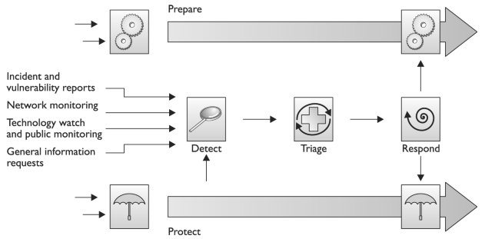
Detect-Triage-Respond

Slide 116
Computer Forensics and Proper Collection of Evidence
The past model did not include forensics and prosecution as that is up to management to decide and not all companies will try to prosecute (why not?)
If we do try to prosecute there are some concepts we need to understand.

Slide 117
Forensics
First of Digital forensics is the science for the recovery and analysis of electronic data on computer systems.
There are specific processes in how to do forensics and anyone that is involved in digital forensics work should be properly trained. There are many steps that you need to take when doing forensics not following best practices can destroy or invalidate critical tracking information and evidence.
(more)

Slide 118
Forensics
Before doing any investigative work on a system the system should
Have a memory dump preformed.
Duplicate the hard drives, only do forensics work on the duplicated hard drive as not to contaminate critical system data.
Forensics investigators should have an notebook (with pages not easily removed), camera and evidence id tags.

Slide 119
Motive Opportunity and Means
Just like regular crimes it is necessary to understand the Motive Opportunity and Means of computer crimes.

Slide 120
Forensics process
Forensics investigations should follow a standard set of procedures
Identify – that a crime has been committed
Preservation* - preserve original data*
Only allow authorized individuals to the crime scene.
Take many pictures of the scene
Duplicate the hard drive using a bit level copy (ex. dd on Unix) make at least 2 copies (primary/control) and working image
Create hashes on files before analysis (why)

Slide 121
Forensics process
Collect – collect all relevant data for analysis
Examine – pretty obvious
Presentation – present findings
Decision

Slide 122
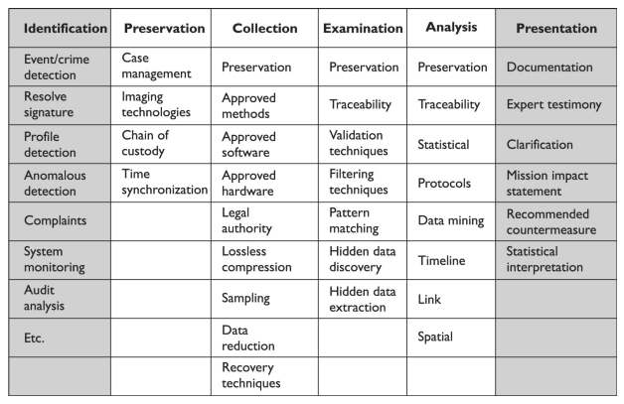
Forensic Process Investigation Stages

Slide 123
Forensics process
It is critically important that when dealing with evidence a proper chain of custody is kept.
Photographs should be taken before equipment is disassembled.
All evidence gathered MUST be marked in some way with the date, time, case number and initials of the collector.
Any time evidence is accessed/opened, similar information should be kept in the chain of custody log (just like on CSI etc)

Slide 124
Evidence and Court

Slide 125
What is admissible in Court?
Generally computer evidence is considered hearsay meaning the evidence is “secondary” evidence (later)
Hearsay is not generally admissible in court.
For computer evidence to be admissible there should be the testimony of a security person that generated the logs and collected and analyzed them.
Logs used must be generated as the normal part of business activities and not just for this single event.*
Chain of custody tries to show that the evidence has not been tampered with.

Slide 126
Evidence
Any evidence that is introduced should have the following attributes
It is sufficient – must be persuasive enough to convince someone of it’s validity, it cannot be subject to interpretation.
It is reliable – it must be consistent with the facts, cannot be based on opinions or copies of an original document (that’s where digital evidence often has problems)
(more)

Slide 127
Evidence
It is relevant – must have a reasonable relationship to the findings.
It is legally permissible – obtained in a legal way

Slide 128
Evidence Types
There are a few categories of evidence that you need to be aware of
Best Evidence – most reliable evidence, (ex. An original signed contract), physical evidence
Secondary Evidence – not viewed as reliable. Oral evidence such as a witness testimony or copies of an original document are secondary evidence.
(more)

Slide 129
Evidence Types
Direct Evidence – evidence that can prove a fact all by itself and does not need backup information. Presumptions are not required. Example is testimony of a direct witness to a crime. (this is secondary in nature, but does not require evidence to back it up). Often based on information gathered by the 5 senses.

Slide 130
Evidence Types
Conclusive Evidence – irrefutable and cannot be contradicted. Does not require corroboration.
Circumstantial Evidence – can prove an intermediate fact, which then be used to assume the existence of another fact. (example if someone said a friend said he was going to take down eBay)
(more)

Slide 131
Evidence Types
Corroborative Evidence – supporting evidence that is used to help prove an idea or a point. It cannot stand on it’s own but is used to help prove a primary piece of evidence.
Opinion evidence – opinions cannot be used in testimony, unless the opinion is that of an expert in a field.
(more)

Slide 132
Evidence Types
Hearsay Evidence – oral or written evidence presented in court that is secondhand and has no firsthand proof of accuracy or reliability. This is most computer log evidence
However If documents are made during regular business routines, they may be admissible
(more)

Slide 133
Evidence Types
Admissibility is based on the following
Procedures for collecting and maintaining evidence
Proof of how errors were avoided
Identification of custodial and skill set
Reasonable explanation for
Why certain actions were taken
Why specific procedures were bypassed
Note, logs created on a one time basis are NOT allowed.*

Slide 134
Ethics

Slide 135
Ethics (ISC)
Any computer security professional should follow a code of ethics, ISC will ask you about ethical questions on the exam.
You should know their basic code
Act honorably, honestly, justly.. To protect society
Work diligently, provide competent services, and advance the security profession
Encourage, teach, mentor and value the certification
Discourage FUD, and do not consent to bad practices
(more)

Slide 136
Ethics (ISC)
Observe all contracts and give prudent advice
Avoid conflicts of interest, and take only the jobs you are qualified for
Stay current on all skills

Slide 137
Computer Ethics Institute
10 commandments – read on 907

Slide 138
IAB
Internet Architecture Board – is generally concerned with the following unacceptable behavior
Seeking to gain unauthorized access to internet resources
Disrupting the use of the Internet*
Wasting resources*
Destroying the integrity of computer based information
Compromising the privacy of others
Conducting Internet-wide experiments

Slide 139
Ethics
You should also be aware of things that are not ethical or ethical fallacies
Attacking system to “learn” even if you don’t intend harm
Virus writing is NOT protected by the first amendment.
Information should be free so it’s OK to distribute copyrighted material or private data

Slide 140
Additional Concepts

Slide 141
Additional Key Terms

Slide 142
Final Thoughts

Slide 143
Final Thoughts
Crime over the Internet has brought about jurisdiction problems for law enforcement and the courts.
Privacy laws dictate that data collected by government agencies must be collected fairly and lawfully, must be used only for the purpose for which they were collected, must only be held for a reasonable amount of time, and must be accurate and timely.
If companies are going to use any type of monitoring, they need to make sure it is legal in their business sector and must inform all employees that they may be subjected to monitoring.
Employees need to be informed regarding what is expected behavior pertaining to the use of the company’s computer systems, network , e-mail system, and phone system. They need to also know what the ramifications are for not meeting those expectations. These requirements are usually communicated through policies.

Slide 144
Final Thoughts
Logon banners should be used to inform users of what could happen if they do not follow the rules pertaining to using company resources. This provides legal protection for the company.
Countries differ in their view of the seriousness of computer crime and have different penalties for certain crimes. This makes enforcing laws much harder across country borders.
The three main types of harm addressed in computer crime laws pertain to unauthorized intrusion, unauthorized alteration or destruction, and using malicious code.
Law enforcement and the courts have a hard time with computer crimes because of the newness of the types of crimes, the complexity involved , jurisdictional issues, and evidence collection. New laws are being written to properly deal with cybercrime.
If a company does not practice due care in its efforts to protect itself from computer crime, it can be found to be negligent and legally liable for damages.

Slide 145
Final Thoughts
Dumpster diving refers to going through someone’s trash to find confidential or useful information . It is legal, unless it involves trespassing , but in all cases it is considered unethical.
Wiretapping is a passive attack that eavesdrops on communications. It is only legal with prior consent or a warrant.
Social engineering is the act of tricking or deceiving a person into giving confidential or sensitive information that could then be used against him or his company.
The primary reason for the chain of custody of evidence is to ensure that it will be admissible in court by showing it was properly controlled and handled before being presented in court.
Companies should develop their own incident response team, which is made up of people from management, IT, legal, human resources, public relations, security, and other key areas of the organization.
Hearsay evidence is secondhand and usually not admissible in court.
To be admissible in court, business records have to be made and collected in the normal course of business, not specially generated for a case in court.

Slide 146
From Authorities to Audits
Examples
Technical, physical, and administrative requirements that must be in place to ensure compliance with the authorities
Statements of how a company will implement and enforce requirements
Implementation of the technical, physical, and administrative requirements found in the policy statements
Verification of appropriately implemented controls to comply with requirements
PCI
HIPAA
NERC
Authorities
Requirements
Policies
Controls
Audits
PCI-DSS Example
Authority: PCI-DSS is the authority document created by the PCI-SSC.
Requirement: (10.6) Review logs for all system components at least daily.
Policy: Monitoring Policy – States logs will be reviewed at least daily.
Control: Tool XYZ provides real-time monitoring for all system components.
Audit: Auditor verifies Tool XYZ is appropriately monitoring and alerting to actionable events. Audit results and evidence are stored as part of the audit.

Slide 147
Effectively Managed IT Controls
Technology can affect every part of the business.
At its best, technology is a competitive advantage.
At its worst, technology is your competitor’s advantage.
Product
Market Relationships
IT Controls:
Detective, protective and reactive measures in place to protect the confidentiality, integrity, and availability of business information and ensure appropriate management of the IT function to meet business objectives.
Inbound Logistics
Operations
Outbound Logistics
Marketing
and Sales
Service
Firm Infrastructure
HR Management
Margin
Procurement
Technology Development
Notes:
Compliance Control: A process, effected by management and other personnel, designed to provide reasonable assurance that transactions are executed in accordance with 1) laws governing the use of budget authority and other laws and regulations that could have a direct and material effect on the financial statements or required supplementary stewardship information and 2) any other laws, regulations, and government wide policies identified in OMB audit guidance. [GAO/PCIE Financial Audit Manual]
Source: http://www.unifiedcompliance.com/it_compliance/language_compliance/definitions/c.html

Slide 148
Chris Davis
UTD Email: cmd140430@utdallas.edu
Google Voice: 214-771-8122
Course Materials
https://elearning.utdallas.edu

Slide 149
Additional Materials

